Slide 1
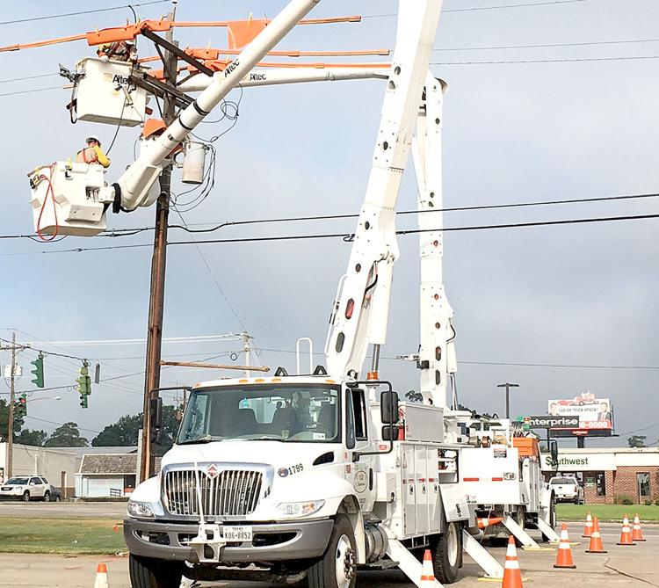

Installing Power Poles
GARS Workshop: July 20 2021
Dallas N4DDM

Slide 2
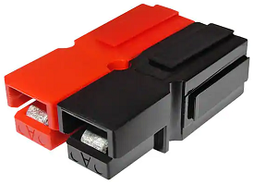
OOPs…
Installing Anderson Powerpole Connectors

Slide 3
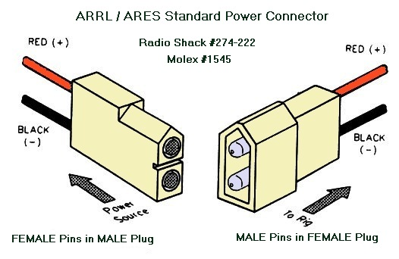
A little history on the Standard ARES Connector
Before we switched to the Anderson Powerpole we used the Molex 1545
Only good for VHF/UHF rigs, 8-12 amps.
2 different housings (Male/Female).
2 different sets pins/sockets (Male/Female).
Easy to insert the wrong type of pin.
Sometimes the Male housing could short due to exposed pins.
Would get warm/hot due to poor connection.
The list goes on, but it was a start...

Slide 4
The Anderson Powerpoles fixed most of those issues...
One set of housings, typically Red and Black, but there are 9 other colors.
Your choice of pins for the current you need, 20-10 AWG.
Choices of Tin or Silver plated contacts.

Slide 5
The Data Sheet:
PP15/45 Tin Plated Power Contacts Offer cost effective performance up to 1,500 mating cycles.
PP15/45 Silver Plated Power Contacts Maximize performance offering up to 10,000 mating cycles. (That’s 567% more mating cycles).
The Data Sheet shows types of housings, pins, etc:
https://www.andersonpower.com/content/dam/app/ecommerce/product-pdfs/DS-PP1545.pdf

Slide 6
The Correct Orientation of the Housings:
Before you jam them together get the orientation correct…
If you get this wrong you will fight to get them apart...
The housings have tabs slots to slide them together…
Note; the Male Tabs on the Hoods and the Black Male tab on the side…
If you don’t have the Black tab on the side it is WRONG and will be backwards with all the folks that got it right and all the commercially available products sold by MFJ, Powerwerx, etc...

Slide 7

And now for the video;
But first, corrections to the video:
Note the orientation of the wires and pins before you crimp. You don’t want to twist the wires 180 degrees to make them fit…
Strip both wires before you crimp to make sure you are happy with the lengths of the exposed wire and insulation…
You want the wire to bottom out in the pin as the pin comes in contact to the insulation...
https://youtu.be/t-P4io53AyU

Slide 8
Note the Orientation of the Hoods and Tabs:
Red and Black tabs on top...
Black tab on the side…
You may need to hammer on the housings to get the edges of the housings to line up 100%...
Hoods on top...
You should see the spring steel that forces the pins together…
Note these show pins inserted...
ANY QUESTIONS ???

Slide 9
Break into small groups and let’s get started...
Note to self…
Backup one slide to show the proper orientation of the housings…

Slide 10
So before we clean up and go home...
Does anybody know what the UNIVERSAL ARES connectors looks like?

Slide 11
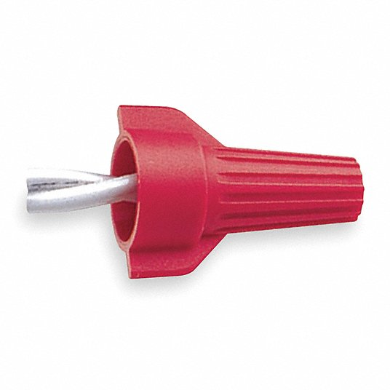
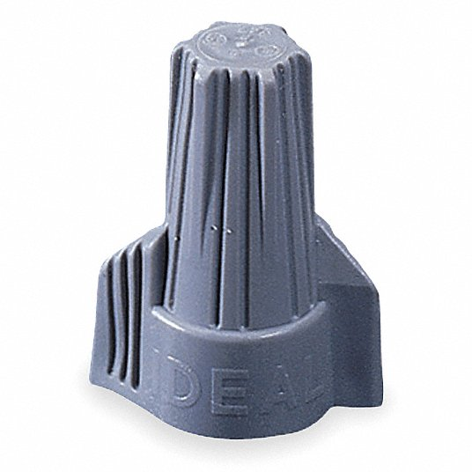
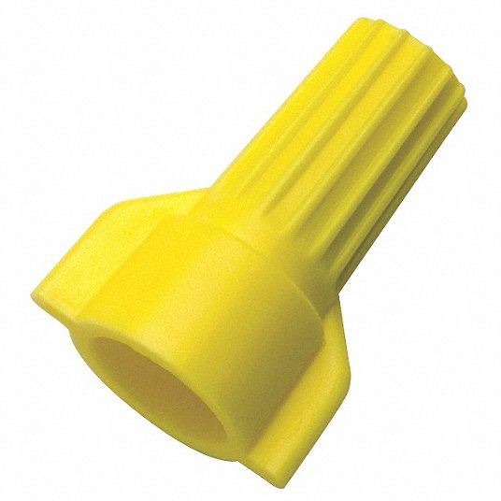
Only taught here… Not in your ARES Taskbook...

